Slide 1

Student Group Class Project Success Classification
Professor: Damber Uprety Akhila Sri
Quantitative Management Modeling Madhukar
MIS-64018-003 Pavan Chaitanya

Slide 2
Agenda
Problem Statement
Project Objective
Methodology
Data Generation/Collection
Formulation Of Problem(Obj function/Constraints)
Solutions
Conclusion

Slide 3

Problem Statement
Twelve students are present in the class, and they are split into four groups of three each. Which group will excel in the class project is the issue we are trying to solve by considering the factors like GPA, gender, and other ones that have an impact on a group's success.

Slide 4

Project Objective
The project’s primary objective is to form groups for the class assignment and to assess or maximize the possibility of how each group will successfully complete the project.

Slide 5
Methodology
Method Used: Integer Linear programming.
Why: Integer Linear Programming helps to discover the best solution while limiting the output to an integer.
This methodology is strongly related to the issue that is stated in the Project as our main goal is to maximize the success of the group by dividing people into 4 different Groups.

Slide 6
Data Generation/Collection
GPA contains data on previous performance. The range is 0 to 4 and gender identifies if a student is a male or female. In our dataset, 0 denotes a man and 1 is a female.
Time spent on the project represents how many hours each person put into the team project. In other words, it assesses whether each student initiated their own work on the project. The range of the Group Project dataset is 0 to 15 hours. Course Grade computes the points earned for the
current course. It assesses how well the students are currently performing in the class.

Slide 7
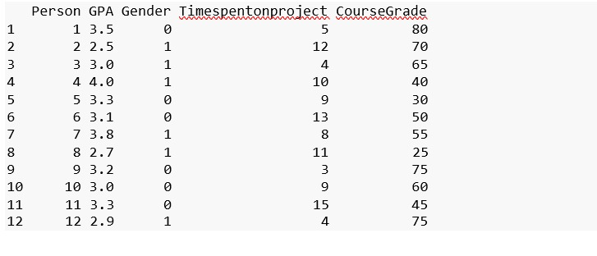
Data Generation/Collection
Created Dataset: The dataset shown here is created randomly.

Slide 8
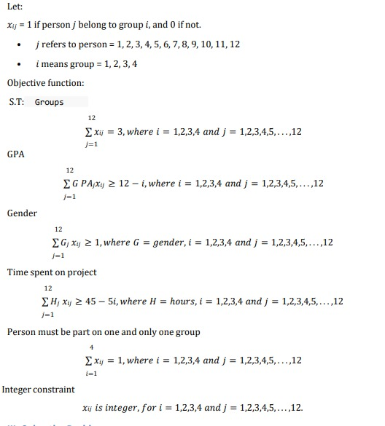
Formulation Of Problem(Obj function/Constraints)

Slide 9
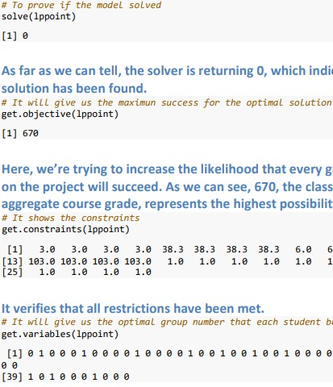
Solutions(Result)
The solutions that are formed for the problem are :

Slide 10
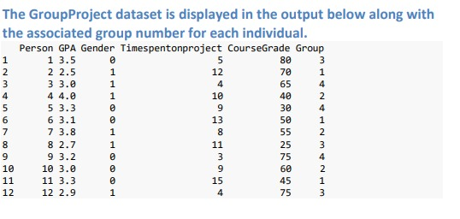
Solutions(Students present in each group)
Students with respect to the groups they belong :

Slide 11
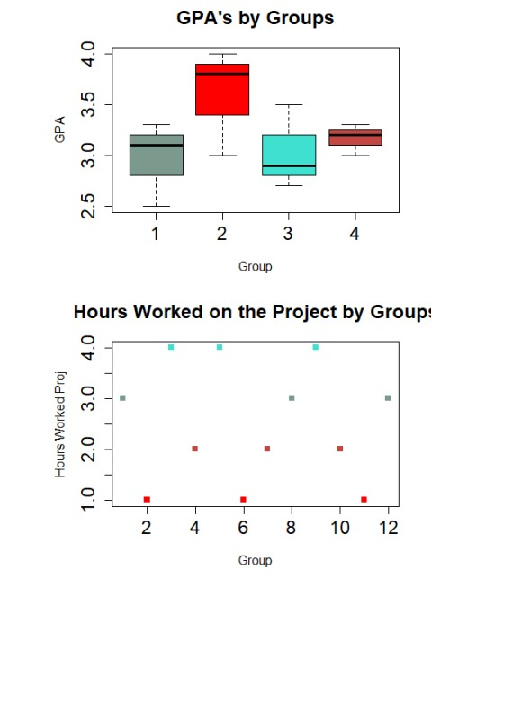
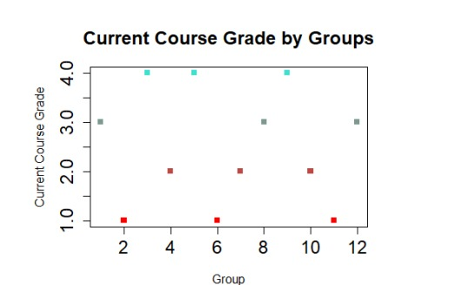
Solutions(Plotting each Factor)

Slide 12

Conclusion
By looking at the results we can clearly say that :
Group 1 has put in the most hours on the project, while Group 4 has put in the least. It usually lasts for four hours.
The GPAs in Group 2 are higher. It is the only group where 100% of the data was focused in the narrow range between 8 and 10, in terms of the hours worked individually on the group project.
When it comes to the present course grade component, Group 3 has a wide range. It includes the dataset’s minimum and maximum, which are outliers, in the same group.
We can observe from the data above that group 2 appears to contain the top kids altogether.
Group 2 is the best compared to all the other 4 Groups.

Slide 13
Thank You

